Slide 1


Test Strategy
Overall Program Strategy
Play to Win SS Ph1 - Dashboard & Warranty

Slide 2
Test Strategy Index
Key Objectives
01
Version Control
Maintain version control of every change/approval
09
Test Scenarios/Features
Scope of Delivery
02
HL Test Strategy and Approach
Open with Executive Summary
10
Defect Management
03
In Scope Testing Cycles (&Out)
11
Entry & Exit Criteria (s): Gating
High level – this can and should be further defined in a specific test plan
04
Assumptions & Dependencies
05
Testing Support
Includes Env, OS, Data, and Resources.
12
Daily Dashboards
06
RACI
13
Cadence and Reporting Tools
Meeting and communication commitments
07
Roles & Responsibilities
08
High Level Timelines/Gantt
Specific timelines to be clarified specifically in Test Plans. This is representative of a Stacked Testing Approach

Slide 3
Version Control
# | Version | Key Updates | Date | Author | Sign off
1 | Initial version of Test Strategy | Draft version presented | 22nd January 2026 | Vishal Kumar | Insert PDF of sign off or link to a shared site where sign off evidence is maintained
2
3
4

Slide 4
Play to Win SS Ph1 - Dashboard & Warranty
Executive Summary
This document defines the overall test strategy, methodology and test approach for Play to Win SS Ph1 - Dashboard & Warranty. The Test Strategy ensures that completed functionalities are properly tested, validated and meet the acceptance criteria defined in the project requirements.
The test process includes objectives, scope, assumptions, constraints, and risk management. In this Test Strategy, the test planning will also be incorporated addressing environment requirements, test scope of each phase (Dashboard & Warranty), required resources and timelines.
This document will serve to communicate expectations of how each stream will engage participants from each team.
To ensure there is no impact to Business operations of Dashboard & Warranty, Test team will conduct thorough testing of a new/existing system and integration between these and existing systems in the Sandbox environments as well as Production, before a Go-Live of each System

Slide 5
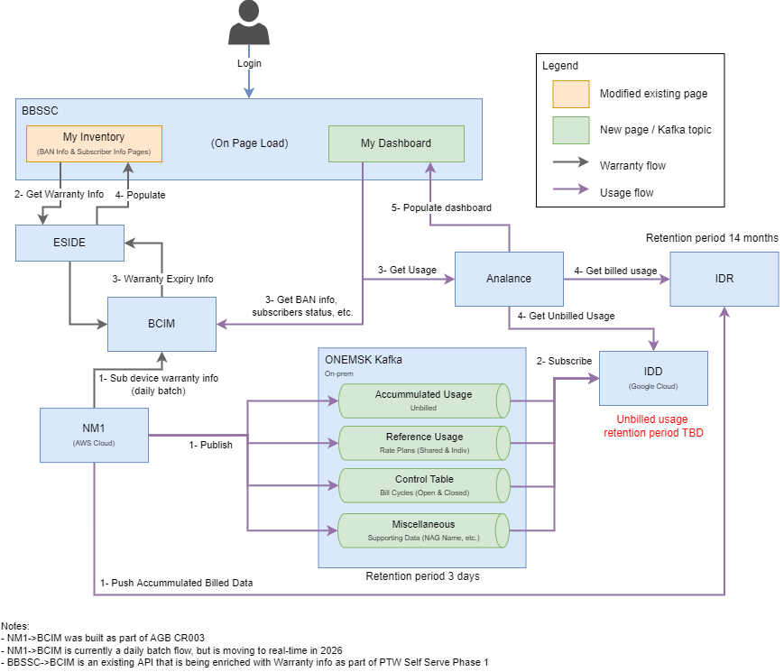
PTW SS Ph 1: Dashboard & Warranty – Overview
The PTW SS Ph 1 - Dashboard & Warranty project's primary goal is to implement key enhancements within BBSSC to improve user experience and functionality for users managing wireless services. Bell needs to introduce these enhancements to streamline wireless device management, improve data privacy, and close the competitive gap with DMI & Telus IQ.

Slide 6

Testing Objectives
Be able to display warranty expiry date information in BBSSC for wireless device based on the purchase date
Objective 01
Overall Objective
Be able to fetch data to display on dashboard based on the Nag and logged in customer and ensure different system's integration/ data flow.
Objective 02
Be able to offer visualization of the key wireless management insights and actions in a single dashboard for wireless services
Be able to represent and provide ability to compare difference metrics
Objective 03
Be able to breakout usage display based on source system and the month
Be able to display different type of usage at glance
Be able to display "Shopping and Orders" widget with ability to shop and show orders as Request ID for "Mobile devices and Plans" service
Objective 04

Slide 7
Testing Cycles In/Out of Scope (our team)
Phase | Env. | Team Accountable | Start | End | In Scope | Dependencies (Ie: Data, hardware)/ )
Static Testing (SPFs will be an added scope) |  | QA Miipe Team | 5th Jan 2026 | 6th Feb 2026 | Yes | BRD and Solution
Developer Test (AKA Unit Test) |  | Development/Infra |  |  | No | Vision Documentation
SFT |  | Amdocs Team | 16th Mar’26 | 12th Apr’26 | No
SIT |  | QA Miipe Team (Part of E2E) | 16th Mar’26 |  | Yes | Involved Systems, Environment and Data
Load & Performance |  |  |  |  | No
Automation |  |  |  |  | No
E2E Full |  | QA Miipe Team | 16th Mar’26 | 3rd Apr’26 | Yes | Involved Systems, Environment and Data
Regression |  | QA Miipe Team | 6th Apr | 17th Apr | Yes | BRD and Solution
UAT |  | BA + leading by QA Miipe Team | 13th Apr | 24th Apr | Yes | E2E Handoff, UAT Test Data, Env
ORT |  | Miipe’s ORT Team |  |  | No | ORT Env, Test Data
DVT |  | QA Miipe Team | 4th May | 8th May | Yes | DVT Environment, DVT Data
Security |  |  |  |  | No
Accessibility |  | To be discussed with Project Team |  |  | No

Slide 8
Test Cycles
Static Testing is a software testing technique to check for defects without executing code. This is done to avoid errors at an early stage of development as it is easier and more cost efficient to solve sooner. It is done through, informal reviews, walkthroughs, technical reviews, inspections etc. This is done by QA during the initial planning phase and as early as requirement and design enhancement.
Static Testing
Unit Test is executed by the individual team’s development vendor. This is also known as Component test. This test is done in the development environment and verifies the stories details within a single module of code before the code is checked in. Unit test is managed and executed by each respective development team
Unit Testing
System Functional Testing
System Functional Testing (System Functional test in the QA’s environment) This test will present the system level functionality to the PTW team and Miipe for purposes of Validation and Verification, to confirm that Story is functional and business details can be tested. This phase is currently not owned by QA Miipe team.
System Integration Testing
System Integration Test (led by SI, executed by the QA Miipe Team & Dev Teams in the QA’s environment) is performed to ensure the applications and all interfaces to external systems perform correctly and can communicate together as per design. Regression, Load/Performance testing also falls within this period (but as part of this project, load/ performance is out of scope)
End to End (executed by the QA Miipe team in the QA’s environment) is performed to validate the functionality, end to end data flow, and reliability of the system from start to finish. It involves testing a complete workflow, simulating real-world scenarios and interactions; the full customer journey.
End to End Testing

Slide 9
Test Cycles
Load & Performance (executed by Dev/Vendor in the QA’s Environment) is performed to assess how well the application performs under various conditions, such as high user loads, stress, and scalability. The primary objective of performance testing is to identify and address potential performance bottlenecks, ensuring that the application can handle the expected user workload without compromising its responsiveness and stability. It helps providing Scalability Assessment, analyzing Resource Optimization (CPU, memory and network), and analyzing Load Distribution under different load conditions for Capacity planning.​ This phase is currently not owned by QA Miipe team.
Load & Performance
Automation Testing
Automation Testing (executed by the Automation QA Eng team) is the application of tools and technology to testing software with the goal of reducing efforts, increasing depth and scope, and improve quality software. It helps deliver capability faster, as lengthy tests are often avoided during manual testing as automation can be run unattended. This phase is currently not owned by QA Miipe team.
Regression (executed by QA Miipe Team in the QA’s environment) is performed to ensure that changes or modifications made to the existing system do not inadvertently introduce new issues and that the previously working functionalities continue to work as expected. It involves retesting the modified components of the system and conducting a selective retesting of unaffected areas to ensure overall system stability.
Regression Testing
User Acceptance Testing
User Acceptance Test (executed by the CLIENT End Users in QA’s environment and guided by Miipe). This test is intended to ensure that the End Users or representatives of the End Users are exposed to a tested version of the application and can test, simulate and experience everyday business transactions in order to ensure that business requirements have been met.
Deployment Verification Testing
Deployment Verification Test (executed by QA Miipe Team in the Production/DVT environment) is performed to ensure that the business capability is correctly deployed in the environment. Tests typically consist of a smaller sub-set of regression test cases where all critical functionality that is deemed critical for the system to be operational is tested

Slide 10
Test Cycles
Operational Readiness Testing
Operational Readiness Testing (executed by the CLIENT End Users in Production environment and guided by Miipe). This test is typically executed within a particular time frame with a controlled set of test scenarios reflective of impacted business scenarios. The intent is to ensure and prove to the End Users that production is stable, and any instability can also be dealt with the appropriate attention expected by the customer.
Accessibility Testing (executed by the Automation QA Eng team) is the practice that websites, tools and technology are created and developed in a way that accommodates people with disabilities. Key areas for accessibility testing include (but not limited to): Web pages, Office & PDF Suite, and mobile applications. WCAG is the main digital accessibility standard in Canada which set the mandates for compliance and regulations. Nikola to review and update Miipe QA team.
Accessibility Testing
Security Testing (executed by Miipe/DEV in the Pre-Prod and Sec Prod environments) The primary objective is to ensure that the “CIA” triad (Confidentiality, Integrity, Availability) is uphold in the application to ensure optimal security. In addition, security testing also includes testing for IAAA (Identification, Authentication, Authorization and Accountability) to ensure unauthorized users are not permitted to use the application. This phase is currently not owned by QA Miipe team.
Security Testing
System Perspective Flows (SPF) (Designed by QA Miipe Team with inputs from CLIENT BA). It refers to a visual representation or diagram that illustrates the sequential and interconnected progression of processes, components, or stages within a system from a holistic viewpoint. The SPF diagram provides an overview of how data, actions, decisions, and interactions flow through a system, highlighting the relationships and dependencies between different elements (applications/software/users). SPFs are utilized by QA, Business, Dev, SI’s etc. throughout the life of program delivery and products ongoing maintenance.
System Perspective Flow

Slide 11
Risks, Assumptions and Dependencies
No. | Issue Type (risk, assumption, dependency) | Description | Impact | Severity of Impact | Mitigation Plan if applicable
1 | Assumption | QA assumes requirements/ design will not change during testing | Major change in design/ requirement during execution phase can cause rework/ timeline delay/ defect leakage | High | Change Management process Track Solution/ Design changes and test updates
2 | Assumption | QA assumes test environment behaves like PROD | New defects may appear in DVT/ Prod due to Environmental discrepancy | High | - Align test and PROD Configuration
3 | Dependency | QA is dependent on Dev/ Infra for necessary test data/ simulation process | Testing may be blocked or incomplete/ Scope crunch | High | Test data in Planning Use of mock if need
4 | Dependency | QA is dependent on on-time code and environment Handoff by Development | Development delay impacts testing activities | Medium | Stacked testing Early handoff of testable features
5 | Risk | Testing has risk of Resource/ Stakeholder unavailability | Delays in feedback/ defect resolution can delay timeline | High | Assign backup contact Or resource

Slide 12
Testing Support
Environment Support
System | Hours | POC/(s) | Contact Detail | Planned Maintenance | B/U
Analance |  | Rashid, Azeez Abiodun | azeez_abiodun.rashid@bell.ca
IDR/ IDD |  | Rashid, Azeez Abiodun Roby, Ghislain | azeez_abiodun.rashid@bell.ca g.roby@bell.ca
NM1 |  | Doshi, Pratik | pratik.doshi@amdocs.com | Change of Env on 6th April 2026
BCIM | Offshore (Until 11:00 AM EST) | McIlwaine, Alexandria | Alexandria.mcilwaine@bell.ca
BBSSC |  | Villemin, Maxime | maxime.villemin@bell.ca
ESIDE |  | Tersigni, Jonathan | jonathan.tersigni@bell.ca
Kafka |  | Hawkes, Richard | Richard.Hawkes@bellaliant.ca
BBP/PARBAC |  | My, Morgan | morgan.my@bell.ca
UI/UX |  | Zambrano Lievano, Mauricio | mauricio.zambrano@bell.ca

Slide 13
Testing Support
Data Required
Source System | Environment | Data Type | Volume of Data | Additional Comments
BBSSC | TBD with POCs | Admin Account with Shopping permission Admin Account WITHOUT Shopping permission Non- admin account User WITHOUT "My dashboard" permission | 1 user of each type | User access to view My dashboard and My Inventory
NM1/ OneMSK Kafka/IDD | TBD with POCs | NAGs | 1
BCIM | TBD with POCs | Billing Accounts and Multiple Subscribers | 1 | NAG must contain a combination of Active, Suspended, Cancelled statuses
IDR/ IDD | TBD with POCs | Historical Billed Usage with Data, Voice, LD, Text Messaging | Required # month's historical data for 1 existing NAG: 14 | * Must have associated multiple Shared Plans & multiple Individual Plans for Roaming, Overage, In-plan categories
NM1/IDD | TBD with POCs | Current Unbilled Usage | Current month data for the given NAG/ BAN | * Must have associated multiple Shared Plans & multiple Individual Plans for Roaming, Overage, In-plan categories

Slide 14
Testing Support
Data Required (Cont.)
Source System | Environment | Data Type | Volume of Data | Additional Comments
NM1/BCIM | TBD with POCs | NAG with cancelled subscribers | 1 NAG with 1-year historical data of cancelled subscribers | Ensure the given NAG has cancelled subscribers of over 1 year (Negative Testing)
NM1/IDD | TBD with POCs | Current Month Unbilled Usage | 1 New NAG's unbilled usage | * Current month data for newly registered customer/ BAN * Must have associated multiple Shared Plans & multiple Individual Plans for Roaming, Overage, In-plan categories * One of the Shareplans and one of the Subscribers Must have more than 10 BANs
NM1 - BCIM - SSC | TBD with POCs | NAG and BAN | 5 NAGs and multiple associated data based on "Additional Comments" | * Multiple Nag and Associated multiple BANs and multiple Subscriber with different Statuses
BBSSC (from EORD) | TBD with POCs | Shopping and Orders data | Last 30 days Orders (Must be more than 5) | * Mobile devices & plans service Orders (Req ID#) for given user profile showing different statuses and creation date

Slide 15
RACI
The RACI Model is a table that clearly identifies roles and responsibilities during the test phase of a project/ program. It outlines who is responsible, accountable, or should be consulted or informed of a particular test activity or deliverable. This approach is particularly useful in communicating all key activities and participant roles and expectations
Responsibility/Resource | SIT |  |  |  |  | E2E/REG/DVT |  |  |  | UAT
 | SIA Prime | SIT Prime | DEV Team | BA Team | Stakeholders | E2E Team | DEV Team | SIA/BA Team | Stakeholders | UAT Team | E2E Team | DEV Team | SIA/BA Team | Stakeholders
Test Schedule | C | A,R | C | C | I | R, A | C | C | I | R, A | C | C | C | I
Test Plan | C | A,R | C | C | I | R, A | C | C | I | R, A | C | C | C | I
Test Case Creation/Update | R | A | C | C | I | R, A | C | C | I | R, A | C | I | C | I
Test Data preparation | R | A | C | C | I | R,A | C | C | I | R,A | R | C | C | I
Requirements Traceability | A | I | I | I | I | R, A | I | I | I | R, A | C | I | I | I
Test Environment | C | R | A | I | I | R | R, A | I | I | R | R | R, A | I | I
Test Execution | R | A | C | C | I | R, A | C | C | I | R, A | R | C | C | I
Test Results Analysis | A | C | C | C | I | R, A | C | C | I | R, A | R | C | C | I
QA Repository Maintenance | R | A | I | I | I | R, A | I | I | I | R, A | I | I | I | I
Defect Management | R | R | A | R | I | R, A | R | R | I | R, A | R | R | R | I
Test Status Reporting | C | A,R | C | C | I | R, A | C | C | I | R, A | C | C | C | I
Technical Support/Defect fixing | C | C | R, A | C | I | C | R, A | C | I | C | C | R, A | C | I
Test Team Training | R | R | C | C | I | R, A | C | C | I | R,A | R | C | C | I
Walkthroughs/ Demos | I | A | R | I | I | A | R | R | I | A | I | R | R | I
Test Cases Signoff | I | A | R | I | I | A | R | R | R | A | R | R | R | R
Test Results Signoff | R | A | C | C | R | A | C | R | R | A | I | C | R | R
LEGEND:
R = Responsible A = Accountable C = Consulted I = Informed

Slide 16
Roles and Responsibilities
The following table identifies the resources and their respective roles and responsibilities during the Test phases
Resource | Responsibility
Project Manager | Final approval of all project deliverables Escalation mechanism for Overall Play to Win SS Ph1 - Dashboard & Warranty Planning prime for budget and schedule
Test Lead/Prime | Assemble Strategy and Plan for SFT, SIT/E2E, Deployment Validation and Regression Testing of the Implementation scope. What will be tested, how it will be tested, when it will be tested (including sequence) Identification of dependencies, assumptions/constraints, and data, including by whom is accountable for providing Define support needed from the other systems (e.g. Source Systems, Middleware) Coordination of E2E, Deployment Validation and Regression test activities Manage and triage defects Host meeting cadences to ensure proper defect fix cadence and troubleshooting sessions Provides QA statuses, along with daily dashboard and report at stand-ups/ status calls Own quality and mitigate delivery risk
Quality Engineers (QE) | Review the following artifacts and provide feedback on content, structure, completeness for detail, and comprehension to support test readiness and execution Requirements (e.g., Epics, Features, User Stories, Use Cases) Design material (e.g., Mock-ups, wireframes, System Integration architecture, mapping data structure, business rules, etc.) Team of testers (by an objective neutral party that did not develop or configure the solution) that validates the functionality released meets the requirements in accordance with the user stories provided by the business Include both positive and negative testing - catching nuances that would have been missed during unit testing by developers and/or implementor Where and when applicable, stress the solution to mimic end user behaviours, including different variations of use of the systems and omissions with varied data, including validating error handling Build a regression package to run regression testing when new builds are released with new configuration/code and/or defect fixes, to ensure any changes impacting previously tested requirements are caught

Slide 17
Roles and Responsibilities
The following table identifies the resources and their respective roles and responsibilities during the Test phases
Resource | Responsibility
Dev Management | Wireframe UX Design Unit/component testing Development plan Defect solutions, Test Support, Automation support, Environment support, deployment execution and support, Production support
BA/Architect | Final approval of all BRD/ Solution Extending right solution and design diagram Offering requirement clarity and solution correction, if needed Carry out UAT or/and ORT execution and other required activity (if any)
Program-Level Overall Test Manager | Leads the QA team and is the overall end to end program test prime Plans and coordinates all systems, integrations layers and 3rd party across all test phases Planning for what systems need to be ready at what point, monitoring progress and flagging risks Definition and assurance of Entry and Exit criteria for all testing gates Manage and Triage defects that are E2E and unclear what system should fix Ensure team handles the issues at a proper velocity Provides QA statuses snapshot across all systems and overall state of testing for the program and not just each system The main goal of the program Prime is to own program-wide quality and mitigate delivery risk across all systems as a single team Interaction with delivery vendor and Bell business team, to be aware of requirements and delivery progress

Slide 18
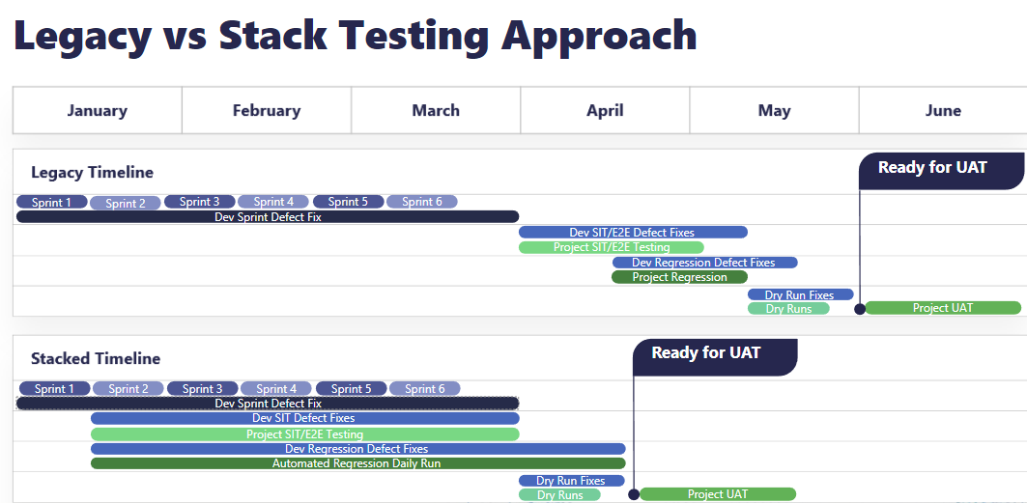
Example of how Stacking Testing Activities Increase Time To Market and UAT Exposure – High-level Timelines
Stacked Testing maintains quality driven project testing, no shortcuts, while reducing the window of execution. Even before enhancing automation, improving functional testing methodology to Stack Testing can Decrease TTM.
Planning the product centric business solutions with a test-driven delivery model early in the planning process allows you to plan for stacked testing. Stacked testing increases your ability to integrate Smart Automated testing earlier to a new product delivery and regression testing.
Legacy vs Stack Testing Approach
Increase in TTM Improvement – early UAT Exposure

Slide 19
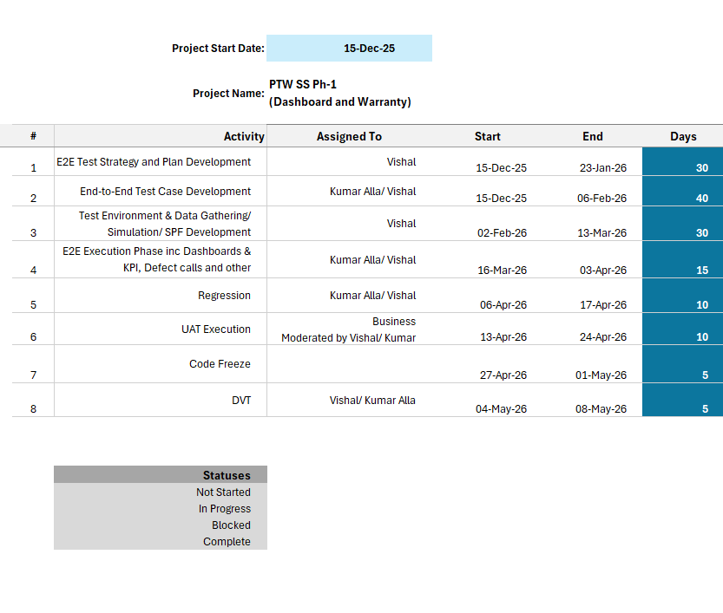
Testing Schedule Gantt

Slide 20
Features In/Out of Scope
Req./Feature ID | Domaine/System | Team Accountable | In/Out of Scope | Impact | Functions to be tested | Dependencies (Ie: Data, hardware)
PTWPH1 - 1W PTWPH1 - 2W | BBSSC | BCIM, NM1, eSide |  | High | Subscriber Page Warranty Display BAN Page Warranty Display | BAN Data and related Information System and Env integration
PTWPH1 – 1 PTWPH1 – 2 PTWPH1 – 3 PTWPH1 - 4 | BBSSC | IDD, IDR, NM1, Analance, BCIM, eSide |  | High | Usage Export Feature NAG (Group) Filter and Favoriting NAG Metric Tiles | NAG and Usage data System and Env integration
PTWPH1 – 5 PTWPH1 – 6 PTWPH1 – 7 PTWPH1 – 8 | BBSSC | IDD, IDR, NM1, Analance |  | High | Usage summary tabs & usage bar chart Interaction prompt under graph | Billed and Unbilled Usage data System and Env integration
PTWPH1 – 9 PTWPH1 – 10 PTWPH1 – 11 PTWPH1 – 12 PTWPH1 – 14 PTWPH1 – 15 | BBSSC | IDD, IDR, NM1, Analance |  | High | Usage bar chart drill down and In-plan Usage Threshold "Donut Wheel“ Shared Plans detail and Usage Breakdown Individual Plans detail and Usage Breakdown | Billed and Unbilled Usage data System and Env integration

Slide 21
Features In/Out of Scope
Req./Feature ID | Domaine/System | Team Accountable | In/Out of Scope | Impact | Functions to be tested | Dependencies (Ie: Data, hardware)
PTWPH1 – 13 PTWPH1 – 16 | BBSSC | IDD, IDR, NM1, Analance |  | Medium | Back button functionality | Billed and Unbilled usage tiles System and Env integration
PTWPH1 – 17 PTWPH1 – 18 PTWPH1 – 19 PTWPH1 - 23 | BBSSC | (EORD) |  | High | Shopping and Orders Widget Latest Orders Table with 30 days Req# Display of View All Orders link | Shopping and Order date System and Env integration
PTWPH1 – 24 | BBSSC | BBP |  | High | Permissions Quick Links and external link | Associate QA links for permissions (TBD) System and Env integration

Slide 22
Defect Severity, Priority and Heat Map
To effectively manage defects, it's important to classify them by their severity and priority. Severity is the impact a defect has on the system, while priority is the level of urgency to fix the defect.
Using both factors, you can create a heatmap that shows which defects need to be addressed first. Use color coding to indicate the severity levels and priority levels. This will help your team stay organized and focused on the most critical issues.
**If a defect is opened and later defined as a change request, the defect must be closed and associated to a CR which should follow a predefined CR Process outside of the defects. The relating test cases should be adjusted or descoped based on the agreement for the CR.

Slide 23
Defect Severity vs Defect Priority
Defect Severity
Defect Priority
The definitions indicate the degree of negative impact on the quality of software. Severity is driven by functionality.
Prioritization should be based on the potential impact of the defect on the system and the users. Effective prioritization can help you efficiently allocate your resources and improve customer satisfaction.
^{Severity} | ^{Functionality}
^{S1 (Critical)} | Core functionality is totally broken, thereby blocking further testing. There is no workaround
^{S2 (Major)} | Isolated aspect of core functionality totally broken, OR an isolated problem with a core feature. No reasonable workaround is available.
^{S3 (Medium)} | Isolated aspect of a feature experiencing an isolated problem. Obvious workaround is available.
^{S4 (Low)} | Minor issues, such as visual glitches/inconsistencies/does not meet specification - that do not impede customer from using the service.
Priority | Customer Impact
^{P1} | All users will encounter the issue on the core path
^{P2} | All average users will encounter the issue on non-core path
^{P3} | Some users, some of the time will encounter the issue
^{P4} | Very unlikely to be encountered by the average user.

Slide 24
Defect Heat Map
Example Guideline for defect management and triage prioritization
^{Severity/ Priority} | ^{S1} | ^{S2} | ^{S3} | ^{S4}
^{P1} | ^{Critical} | ^{Critical} | ^{Critical} | ^{Major}
^{P2} | ^{Critical} | ^{Critical} | ^{Major} | ^{Medium}
^{P3} | ^{Critical} | ^{Major} | ^{Medium} | ^{Minor}
^{P4} | ^{Major} | ^{Major} | ^{Minor} | ^{Minor}
^{Risk Level} | (How Developer sees the priority)
^{Critical} | ^{This must be fixed immediately}
^{Major} | The problem should be fixed in the next Release, or a workaround must be issued and accepted by client
^{Medium} | It can be deferred by client until a future release or to an agreed upon time by both client and Vendor
^{Minor} | These defects can be considered as technical debt.

Slide 25
Defect SLA & SLO
SLA stands for Service Level Agreement, and SLO stands for Service Level Objective. Both SLA and SLO are terms commonly used in the context of service management to define and measure the performance and quality of services provided to customers or users. While they are related, they have distinct purposes and characteristics.
SLAs are formal agreements that define the service commitments made to customers, while SLOs are specific, measurable objectives used to assess the actual performance of the service. SLOs often serve as the basis for setting SLA targets, and both are critical in ensuring the quality and reliability of services provided by service providers or vendors.
Defect SLA:
Defect SLO:
Defect management SLAs typically contain conditions defined by level of priority of defect in Heatmap. The most common are response time and resolution time, but others may include time to triage and time to deliver root cause analysis (RCA).
The benefit having service levels vary by defect heatmap allows the provider to match the urgency with the impact of the defect. The higher the impact, the greater the sense of urgency to respond and resolve.
The purpose of an SLO is to provide a clear, measurable objective that the Client aims to achieve. An SLO is a specific target or goal set by a Client to measure the performance of a service. SLOs are typically more granular and specific than SLAs and may be used internally by the Client to track and manage service performance. SLOs are often used as a basis for setting SLA targets, but they may not always be explicitly stated in customer-facing agreements. Monitoring SLO performance allows the provider to proactively identify areas for improvement and ensure that the service meets the desired quality levels.

Slide 26
Defect SLA During the Development Cycle
Defect SLA Post Deployment
During Development Cycle, there are no actual customers, therefore the SLA can be longer. Below is a guideline for managing SLAs within agreed plan with Development and MSAs
Post Deployment there are actual live customers who will be impacted, therefor the SLA guide is more restrictive.
^{Risk Level} | ^{Definition} | ^{Target Response Time} | ^{Target resolution time} | ^{Follow-up}
^{Critical} | These defects need to be acknowledged within one business day. This has a major impact on the customer or testing. This must be fixed immediately. | ^{1 day} | Immediately in the same code release/code drop | Review the defect in every defect call and request for the update.
^{Major} | These defects need to be acknowledged with in 2 Business Day. This has a major impact on the customer or Testing. The problem should be fixed in the next Release, or a workaround must be issued and accepted by client | ^{2 days} | Resolution should be in the next code release/code drop | Review the defect in every other defect call after reviewing all the critical tickets
^{Medium} | These defects need to be acknowledged within a week. The flaw should be fixed if there is time, but it can be deferred by client until a future release or to an agreed upon time by both client and Vendor | ^{5 days} | Resolution should be in the agreed upon code release/code drop | ^{Review the defects once a week}
^{Minor} | These defects need to be acknowledged within the same release and fix need to provide whenever possible. These defects can be considered as technical debt. | ^{10 days} | Technical debt that needs to be fixed eventually by vendors | ^{N/A}
^{Risk Level} | ^{Definition} | ^{Target Response Time} | ^{Target resolution time} | ^{Follow-up}
^{Critical} | These defects need to be acknowledged within one business day. This has a major impact on the customer or testing. This must be fixed immediately. | ^{30 Min} | Whitin 4 Hours or an estimated resolution time must be given, within 4 hours. | No resolution information at 4 hours/no response by 30 min
^{Major} | These defects need to be acknowledged with in 2 Business Day. This has a major impact on the customer or Testing. The problem should be fixed in the next Release, or a workaround must be issued and accepted by client | ^{4 hours} | Resolution within 24 hours, or an estimated resolution time must be given, within 24 hours. | Review the defect in every other defect call after reviewing all the critical tickets
^{Medium} | These defects need to be acknowledged within a week. The flaw should be fixed if there is time, but it can be deferred by client until a future release or to an agreed upon time by both client and Vendor | ^{24 hours} | Resolution within 48 hours, or an estimated resolution time must be given, within 48 hours. | ^{Review the defects once a week}
^{Minor} | These defects need to be acknowledged within the same release and fix need to provide whenever possible. These defects can be considered as technical debt. | ^{3 Business days} | Resolution within 72 hours, or an estimated resolution time must be given, within 72 hours. | ^{N/A}

Slide 27
Entry & Exit Criteria
The following table identifies Entry and Exit Criteria for SIT/E2E Testing Phase
 |  | Entrance criteria | Exit criteria
Gating Criteria | SIT/E2E | Test Plan is produced, reviewed and approval obtained. Scope of testing is defined and approved SIT/E2E Test Cases including steps and expected results are documented and approved Testing track sheet and Defect tracking tool are configured and available for use. Dashboard is ready Unit Test and System Functional Testing are completed with no Severity 1 defects System Integration Test Environment Cycle 0 Test (Smoke/Sanity) is Complete Delivery dates and content for each code drop is defined and approved Development and Environment support is lined up and confirmed to be available during SIT and E2E execution Environment for test execution including any inbound and outbound interfaces has been setup, configured and populated with all hardware, software, reference/master data, network and data components required to execute Test Plan Test data requirements identified, and data is uploaded to the SIT + E2E environment Designated Testers have access to proper environment for SIT and E2E Testers have installed all necessary software on their machines | 100% Test Cases have been executed with actual results documented (pass/fail logs). Any deviations are documented and agreed by Business Representatives and project team. Any deviations from the original Test Plan have been documented and approved Defects: All defects reported during Test execution have been documented and resolved with acceptable dispositions (including root cause analysis). No severity 1 or 2 defects outstanding An approved plan to address Priority 3 and Priority 4 defects Status reports documenting results of all testing performed have been produced and distributed SIT/ E2E Test Final Report shared during daily stand-up Appropriate metrics collected Sign-off documents are prepared and signed

Slide 28
Entry & Exit Criteria
The following table identifies Entry and Exit Criteria for UAT
 |  | Entrance criteria | Exit criteria
Gating Criteria | UAT | UAT Testers are trained on how the system functions UAT Testers have installed all necessary software in their machines UAT testers understand the agreed scope of the UAT SFT and SIT teams delivered all SFT and SIT Test Scenarios and Conditions with Passes and Fails as well as Defect resolutions and retest results, along with a defect report of SIT Defects Development and Environment support is lined up and confirmed to be available during UAT execution Environment for test execution including any inbound and outbound interfaces has been setup, configured and populated with all hardware, software, reference/master data, network and data components required to execute UAT Test Plan Test data requirements identified, and data is uploaded to the test environment UAT Testers have access to proper environment for UAT UAT testers have installed all necessary software on their machines | 100% Test Cases have been executed with actual results documented (pass/fail logs). Any deviations from the original UAT Test Plan have been documented Defects: All defects reported during Test execution have been documented and resolved with acceptable dispositions (including root cause analysis). No severity 1 or 2 defects outstanding An approved plan to address Priority 3 and Priority 4 defects Status reports documenting results of all testing performed have been produced and distributed

Slide 29
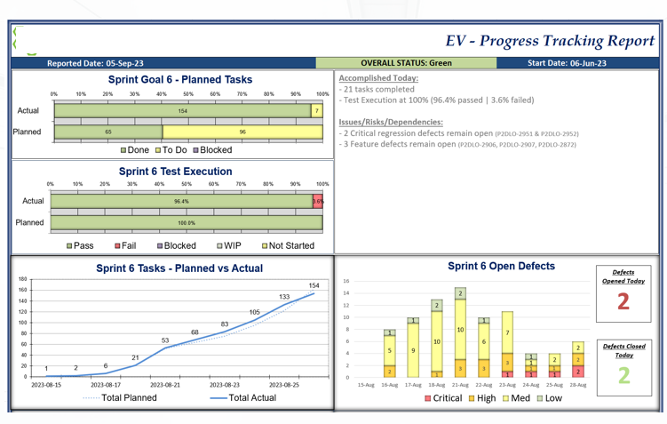
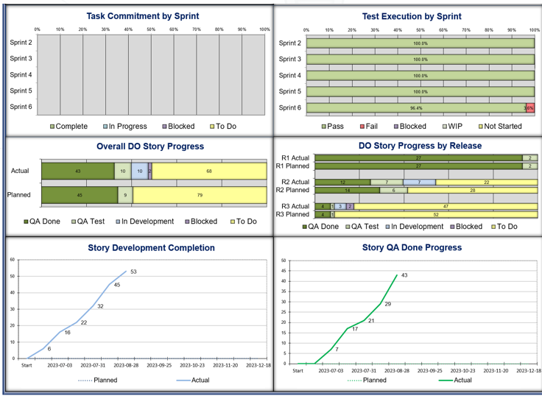
Sample Daily Dashboard

Slide 30
Test Management – Cadence, Tools & Dashboards
The following test management tools and processes will be used to plan, monitor, execute and report testing activities
QA Scrum Agile Board:
QA JIRA board will be created to host all User Stories/Test Cases, track and update the status and effort
QA Board Link: insert your link to your Jira Board or tool
Test Plan:
The Test Plan is located here: Insert link to the related test plan here (including the subpage IE: Accessibility testing)
Automation Test Strategy if in Scope: Insert link to the related automation strategy here
Test Case Management:
Jira Xray will be used for test cases creation, execution and reporting
SIT and E2E test cases will be linked to features/user story in Jira and Confluence
JIRA/Xray: Link
Confluence: Link
UAT test cases will be linked to Features
Link
All necessary screenshots and test results will be saved during the test execution
Defect Management:
Defects will be tracked and managed in JIRA. The Defect lifecycle is explained in subsequent slides
Reporting:
The testing status will be reported in Miipe dashboard and will be communicated to the Play to Win SS Ph1 - Dashboard & Warranty team in a consolidated email for all phases in progress. (Sample later in deck)
The dashboard will measure the following key dimensions:
Overall Status: Overall Status of testing (Green, Yellow, Red), Planned execution vs Actual execution, Risks and issues.
Test Case Completion: Number/percentage of tests planned, executed, passed, failed or blocked to track the progress of the test execution within each iteration
Test Schedule: List of test activities accomplished on the report date and plan for the upcoming day.
Defects List: List of Severity 1 and Severity 2 open defects
Ad hoc reporting:
The Test Primes may use JIRA and X-Ray to provide an instant, detailed representation of the testing current status, including the status of defects

Slide 31
Test Strategy
Questions??
&
Appendix!!

Slide 32
Test Coverage with System Perspective flows (SPF)
Test Case Scenario Tracking:
In this program, our approach to testing will be enriched by leveraging the System Perspective Flows (SPF) methodology. This strategic choice will empower us to meticulously develop and craft test case scenarios, ensuring the thorough examination of all system flows during the testing phase.
SPF CMO (Current Mode of Operations):
We will employ SPF CMO as a pivotal component of our Regression testing efforts. This will facilitate the assessment of the system's stability and reliability in its current operational mode.
SPF FMO (Future Mode of Operations):
For SFT, SIT (System Integration Testing), E2E (End-to-End), and other crucial testing phases, we will utilize SPF FMO to project the system's behavior in its future operational mode. This forward-looking perspective is essential for robust and forward-compatible testing.
Defect Impact Tracking:
From a defect perspective, it's imperative to trace the specific SPF(s) impacted by any identified defects. To streamline this process:
New Jira Field for SPF:
We propose adding a dedicated Jira field for SPF, allowing us to capture the SPF ID(s) influenced by a defect. This approach offers a structured and efficient way to monitor defect impact across different system perspectives.
Alternative Capture Methods:
If adding a new Jira field for SPF proves challenging, we will explore alternative means, such as utilizing the Label field or other existing Jira functionalities. Our goal remains to effectively capture, and track SPF IDs associated with defects to ensure comprehensive defect management.

Slide 33



QA Test Phases
SFT
SIT
E2E
UAT
DVT
ORT
Scope: The high level SFT scope is defined in PRE-PI
Purpose: The purpose of SFT is to ensure each function of the application is meeting functional requirements/specifications, by providing appropriate input and verifying the output, validating UI, APIs, Database and error conditions.
Pre-requisite: Unit Test is complete
Environment: QA environment
Led by: Miipe
Executed by: Miipe Quality Engineers
Source documentation: Requirements, BRD, CS,SIA,DEV stories
Scope: The requirement of conducting SIT and the high level SIT scope are determined by the project team in PRE-PI
Purpose : SIT is performed to ensure the applications and all interfaces to external systems perform correctly and can communicate together as per design. The scope of SIT is related to the new and impacted integrations. The systems under SIT can be comprised of hardware, database, software, a combination of hardware and software, or a system that requires human interaction.
Pre-requisite: SFT testing is complete
Environment: QA environment
Led by: Miipe
Executed by: Miipe Quality Engineers
Source documentation: Requirements, BRD, CS,SIA,DEV stories
Scope: The requirement of conducting E2E and the high level E2E scope are determined by the project team in PRE-PI
Purpose : E2E is performed to validate the functionality, performance and reliability of the system from start to finish. It involves testing a complete workflow, simulating real-world scenarios and interactions.
Pre-requisite: SFT and SIT testing is complete
Environment: QA environment
Led by: Miipe
Executed by: Miipe Quality Engineers
Source documentation: Requirements, BRD, CS,SIA, Use Cases, Visio diagrams, DEV stories
Scope: The requirement of conducting UAT and the high level UAT scope are determined by the Business team in PRE-PI
Purpose: The testing phase that allows the end-users (or their representatives) to validate that the functionality meets their requirements/stories through hands-on testing.
Pre-requisite: SFT and E2E testing is complete
Environment: QA or UAT environment
Led by: Miipe
Executed by: Business end-users or their representatives (i.e. Business BAs)
Source documentation: Requirements, BRD, CS,SIA, Use Cases, Visio diagrams, DEV stories
Scope: The requirement of conducting DVT and the high level DVT scope are determined by the project team in PRE-PI
Purpose : The testing phase that ensures that the software and any configurations have been successfully deployed into production, by executing a subset of E2E test cases.
Pre-requisite: UAT testing is complete, and all code and configurations have been deployed to Production
Environment: Production environment
Led by: Miipe
Executed by: Miipe Quality Engineers
Source documentation: Requirements, BRD, CS,SIA, Use Cases, Visio diagrams, DEV stories, E2E test cases
Scope: The requirement of conducting ORT and the high-level ORT scope are determined by the Business team m in PRE-PI
Purpose : the testing phase which ensures that all processes, operations and procedural steps from a complete end-to-end perspective are working in a production environment, by executing end-to-end tasks or steps from start to finish.
Pre-requisite: DVT testing is complete
Environment: Production environment
Led by: Miipe
Executed by: Business end-users or their representatives (i.e. Business BAs)
NOTE: a live customer is often used
Source documentation: Business Process Documentation

Slide 34
Roles and Responsibilities
The following table identifies the resources and their respective roles and responsibilities during the Test phases:
Resource | Purpose | Responsibility
PM Project Manager | Project level escalation, planning and sign-off | Final approval of all test deliverables Escalation mechanism for Overall Play to Win SS Ph1 - Dashboard & Warranty Planning prime for budget and schedule
SIT Lead | Primary contact for all SIT testing activities | Discuss the SIT scope with the Play to Win SS Ph1 - Dashboard & Warranty team Create the test cases in Xray, test data, device reservation Coordinate SIT testing, setup execution calls with SIA Prime and Development team Create and manage SIT defects in collaboration with the Development teams Provide SIT status report
E2E Lead | Primary contact for all E2E testing activities | Responsible for test delivery overall, E2E and Regression Testing Develop and implement E2E Test Strategy/ Test Plan Create the test cases in Jira, test data, device reservation Coordinate testing, setup E2E execution calls Work with E2E Scrum Team on day-to-day activities Manage test execution against planned timeline Provide E2E/Regression status report
UAT Lead | Primary contact for all UAT testing activities | Develop and implement UAT Test Plan Create the test cases in Jira, test data, device reservation Coordinate UAT testing, setup UAT execution calls with UAT team Manage test execution Provide UAT report
E2E QA/ Testers | Primary members of the E2E/Regression team dedicated to functional testing domain | Analyze acceptance criteria and develop test scenarios & test conditions for E2E, Regression, UAT, and DVT Execute test conditions and scenarios as per Test Plan and Scrum Master directions for E2E, Regression, DVT Document test results Log defects in JIRA for failed test conditions and re-test as these defects are fixed Support UAT execution Report progress to E2E Lead

